Slide 1
MUF SS19
Feature, Label, Data Set and Prediction

Slide 2
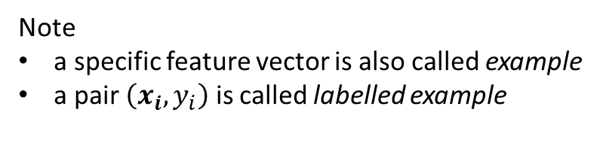
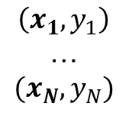
Features Set, Label, Data Set
transform input data and result to a set of (x, y) pairs,
where x is a vector (derived from input data) and y a number (the result)
$$\left(x_{1},y_{1}\right)$$
…
$${(x}_{N}, y_{N})$$
„feature (vector)“
(the vector x)
„label“
(the y value)
„data set of labeled examples“
(the set of all (x,y)-pairs
Note
a specific feature vector is also called example
a pair $\left(x_{i},y_{i}\right)$ is called labelled example

Slide 3
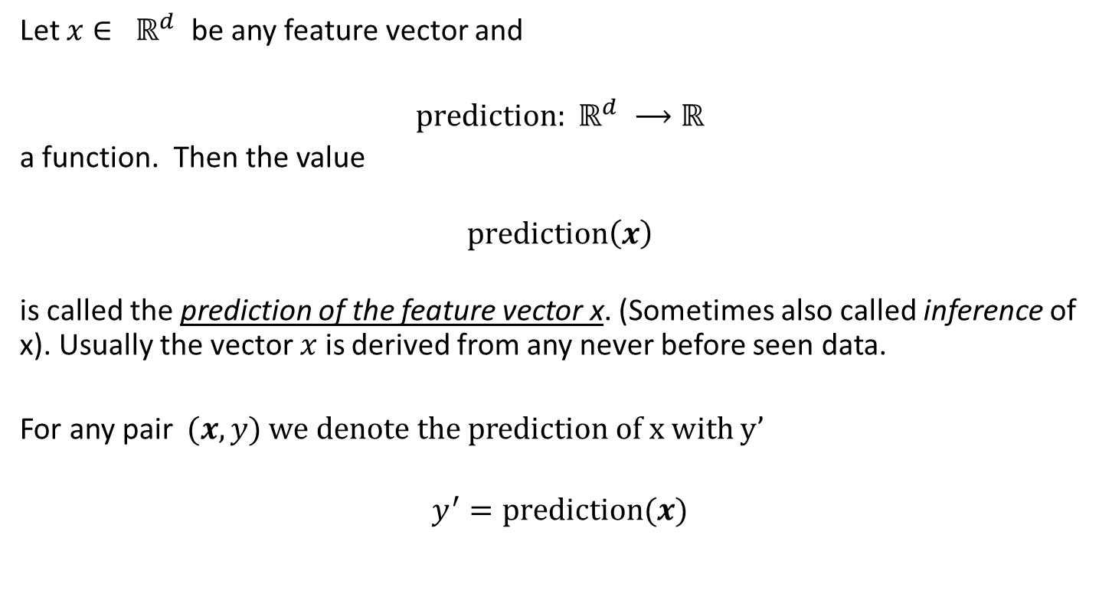
Prediction
Let $x∈ ℝ^{d}$ be any feature vector and
$prediction: ℝ^{d} ⟶ℝ$
a function. Then the value
$prediction\left(x\right)$
is called the prediction of the feature vector x. (Sometimes also called inference of x). Usually the vector $x$ is derived from any never before seen data.
For any pair $(x,y)$ we denote the prediction of x with y’
$$y^{′}=\text{prediction}(x)$$

Slide 4
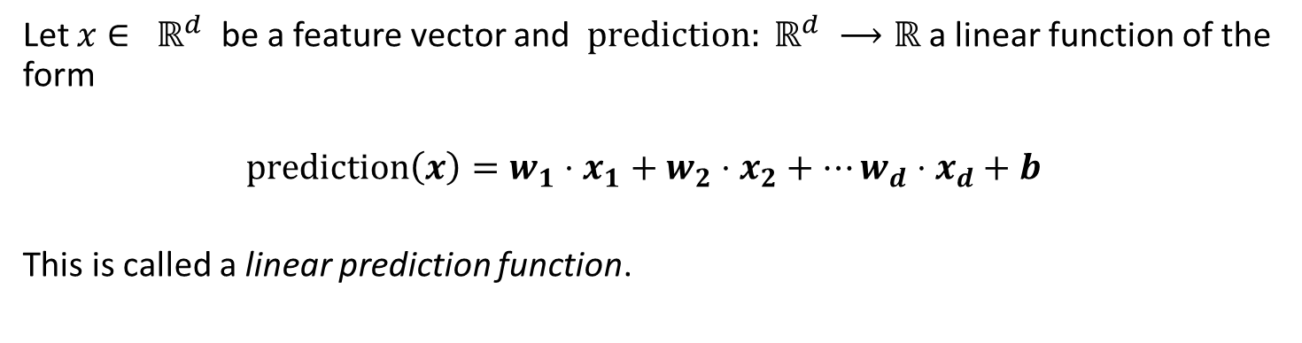
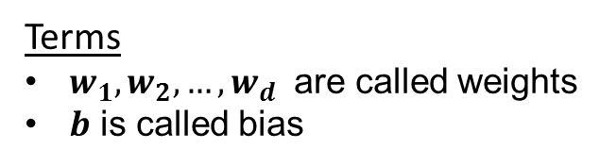
Linear functions as prediction functions
Let $x∈ ℝ^{d}$ be a feature vector and $prediction: ℝ^{d} ⟶ℝ$ a linear function of the form
$$prediction\left(x\right)=w_{1}⋅x_{1}+w_{2}⋅x_{2}+…w_{d}⋅x_{d}+b$$
This is called a linear prediction function.
Terms
$w_{1}, w_{2}, …,w_{d}$ are called weights
$b$ is called bias
Note
A linear prediction function is fully defined by related weights and biases.

